Slide 1
Vehicle spotting in nighttime using Gamma Correction
Guide : Smt. M. Prasana Lakshmi
Assistant Professor
Name : Dasari Rakesh
Roll No. : 228W1F0012

Slide 2
Abstract:
The main theme of this project is to detect vehicles in night time.
recognizes vehicles at night with greater accuracy by improving the contrast between vehicles and the background and by increasing the brightness.
Two Approaches, Image transformation (IMT) approach and the vehicle detection (VD) approach are used to detect the vehicles in the night time
IMT approach convert the Darker image into Brighter image.
Vd approach recognize the vehicles in the image.

Slide 3
Problem statement:
Driving vehicles at the night time is a quite challenging task.
Low Illumination leads to fading of details in image.
To resolve this issue Gamma Correction and HAAR Cascade are used to detect a vehicle in low light conditions.

Slide 4
Existing system:
>Vehicle detection and recognition based on infrared image analysis and
feature extraction process from vehicle >Maximum vehicle detection are done based on the headlights and in Daytime.
Proposed System:
>Vehicle Detection using GAMMA Correction in Image or Videos to
enhance and brighten the image.
>HAAR CASCADE Classifier is used to Identify the Object(Vehicle).

Slide 5
Literature survey:
The headlights/taillights in night images is the main technique to obtain region proposals in previous methods
X. Dai used Hough transforms
In recent years, CNN-based methods are increasingly developed in the research field of vehicle detection at night. GAN(GENERATIVE ADVERSARIAL NETWORKS),
CycleGAN is firstly proposed with cycle consistency loss to realize image translation with unpaired images.

Slide 6
Software reqirements:
Datasets
Google collabs
Ram : 8gb

Slide 7
Modules:
IMT
Image transformation
Gamma correction with the help of opencv is used in this module
Convert night image to day image
Vd
vehicle detection
Haar cascade classifiers are used with the help of opencv To detect vehicles on the image

Slide 8
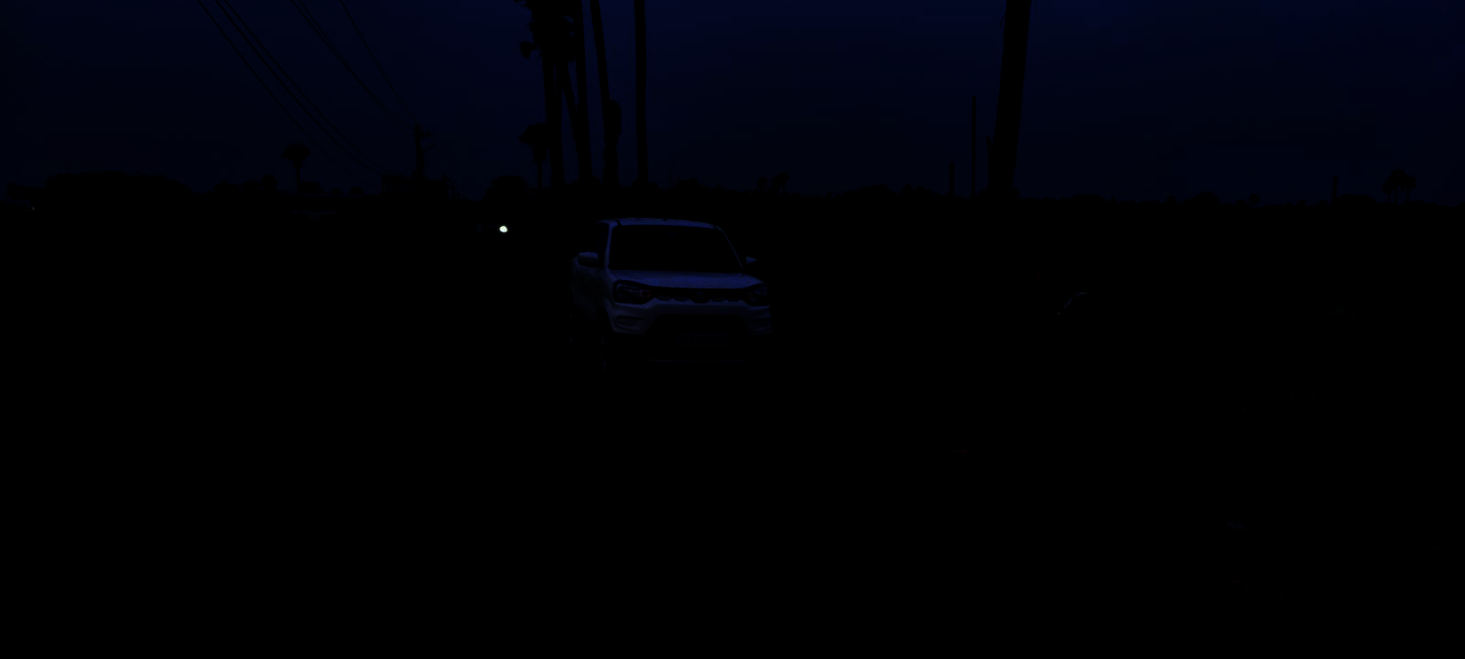
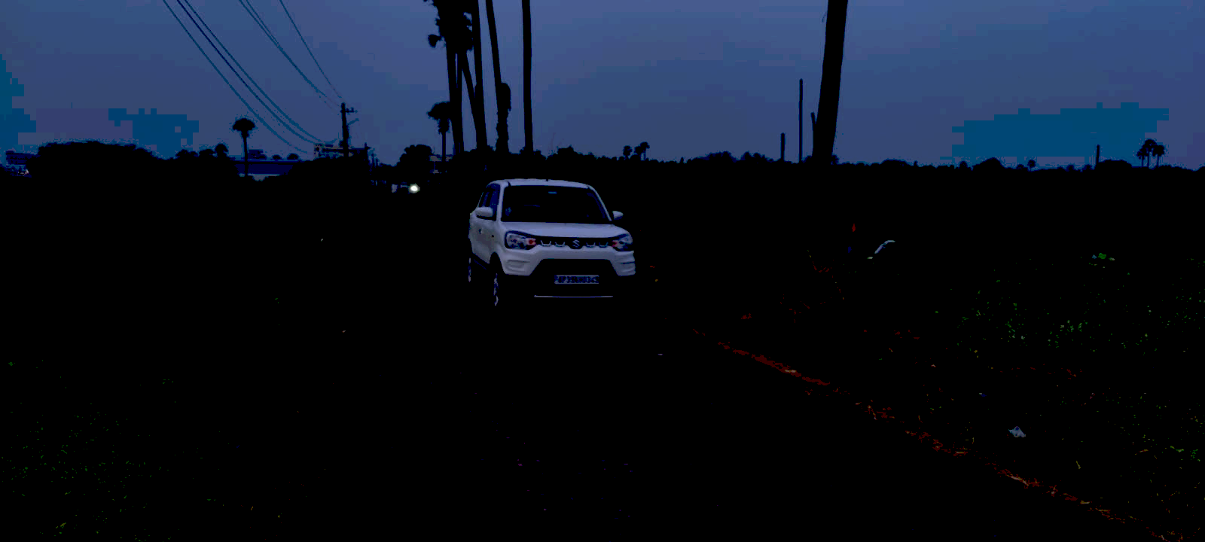
IMT Module (Image Transformation) :
With the help of gamma correction we can change the illumination of image.
After changing the illumination by applying gamma correction.

Slide 9
Gamma Correction:
Gamma correction is used to increase the brightness of dark image.
Non-linear operation to upscale or down scale the intensities of pixels.
Normally raw images have gamma value 1
Intensities increase with increase in gamma correction.

Slide 10
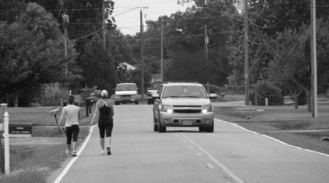

Vd module (Vehicle Detection) :
In Vd module with the help of haar cascade classifiers we can detect vehicles
After applying classifiers

Slide 11
Haar cascade classifiers:
Haar cascade classifier, is a machine learning object detection program that identifies objects in an image and video.
A Haar cascade classifier is a tool that helps computers recognize specific things in pictures or videos, like faces or cars. It works by learning from lots of examples and then scanning images to find those things based on certain patterns it's learned. It's often used because it's pretty quick and doesn't need a lot of computing power.

Slide 12
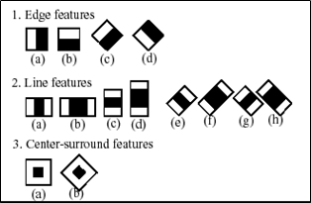
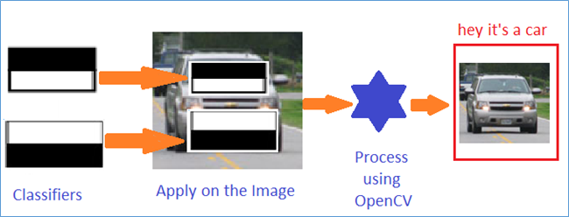

Slide 13
How it works:
Feature Selection: feature selection is simple pattern that are calculated for every pixel in an image.
Integral Image : used to efficiently calculate the sum of pixel intensities over rectangular regions of the image.
Adaboost Training : The AdaBoost algorithm is applied to select a small number of important features and train a strong classifier.
Cascade of Classifiers : The cascade allows for efficient detection by quickly rejecting regions that are unlikely to contain the object being detected.

Slide 14
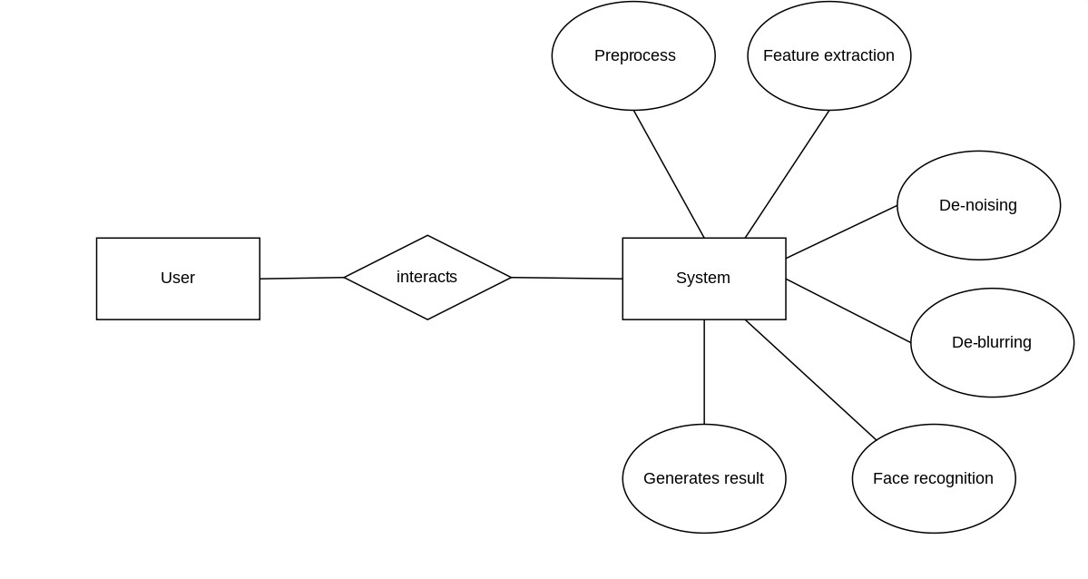
ER Diagram:

Slide 15
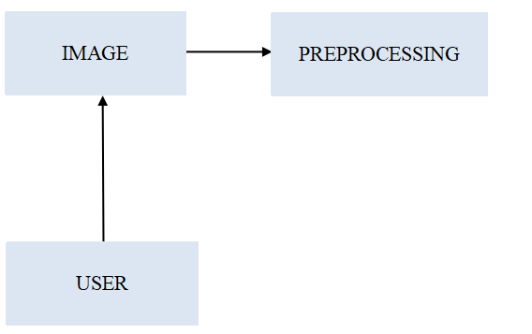
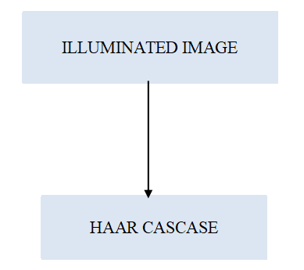
Usecase Diagram:

Slide 16
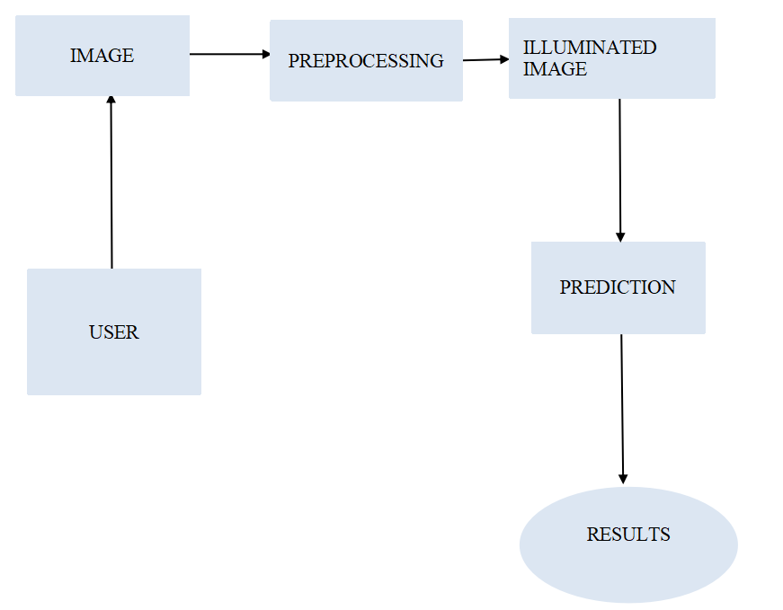

Slide 17
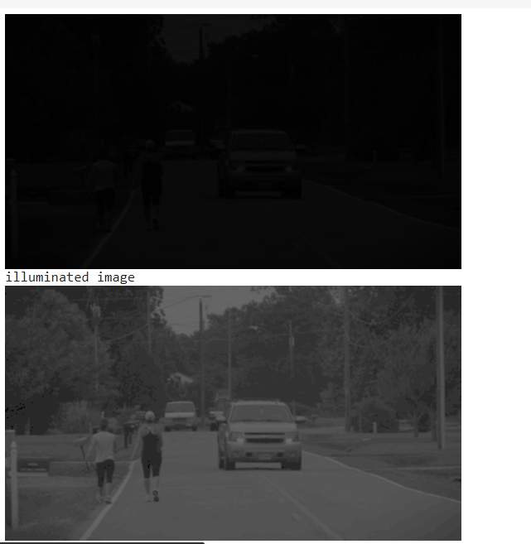
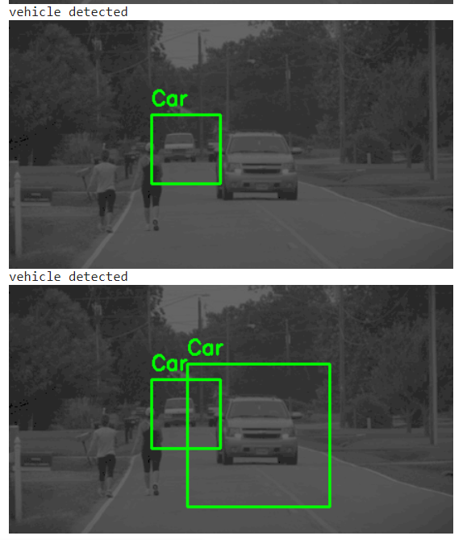
Output:

Slide 18
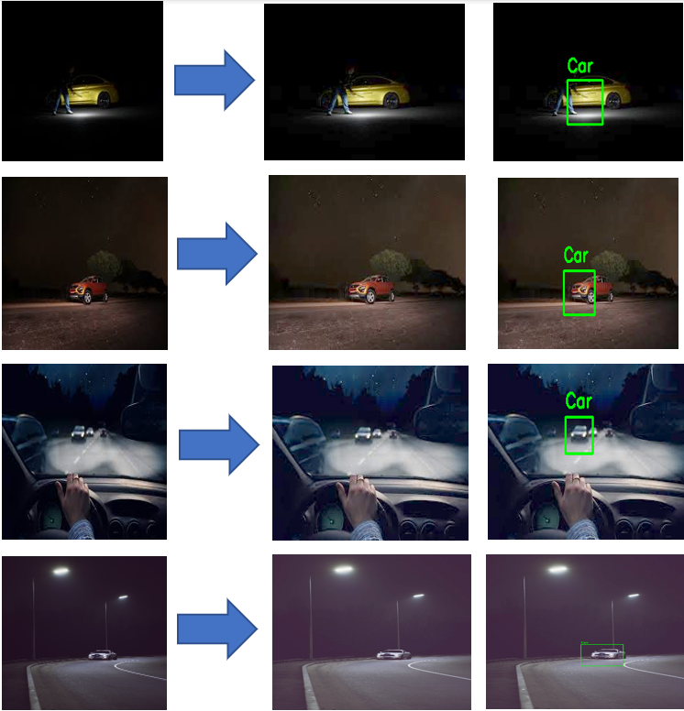
Results:

Slide 19
Conclusion:
By combining the IMT and VD approaches, the project aims to significantly improve the accuracy of vehicle detection during nighttime. The IMT approach enhances image visibility by transforming darker images into brighter ones, while the VD approach utilizes advanced detection algorithms to recognize vehicles within these enhanced images. Together, these approaches offer a promising solution for addressing the challenges of nighttime vehicle detection, potentially improving safety and security in low-light environments.

Slide 20
References:
[1] Hasan Fleych, Iman A. Mohammed, “Night Time Vehicle Detection”, Dalarna University, June 2021
[2] Pabbisetty Nikhitha, Palla Mohana Sarvani, Kanikacherla Lakshmi Gayathri, Dhanush Parasa, Shahana Bano, G. Yedukondalu, “Detection of Tomatoes Using Artificial Intelligence Implementing Haar Cascade Technique”, Published: 05 March 2020. https://link.springer.com/chapter/10.1007/978-981-15-2612-1_15
[3]SrishikaAddala,https://www.researchgate.net/deref/mailto%3Aaddala.11712155%40lpu.in, “Vehicle Detection and Recognition”, Lovely Professional University, Published: May 2020
[4] Xiaotao Shao, Caike Wai, Yan Shen, Zhongli Wang, “Feature Enhancement Based on Cycle Gan for Night time Vehicle Detection”, School of Electronic and Information Engineering, Beijing Jiaotong University, Beijing 100044, China, Publication: IEEE December 22, 2020,
[5] Yingfeng Cai, Xiaoqiang Sun, Long Chen, Haobin Jiang, “Night-Time Vehicle Detection Algorithm Based on Visual Saliency and Deep Learning”, Automotive Engineering Research Institute, Jiangsu University, Zhenjiang 212013, China, Published: 20 Nov 2016, view at: https://doi.org/10.1155/2016/8046529

